Slide 1
AVIATION RISK ANALYSIS

Slide 2
OVERVIEW
Aviation is a common mode of transport yet accidents though rare carry reputational accidents. This projects analyzes historical aviation accident data to:
Uncover patterns over time
Identify low risk aircrafts
Identify factors influencing the accidents

Slide 3
OUTLINE
Business understanding
Data understanding
Data preparation and analysis
Conclusion
Reccomendatios

Slide 4
BUSINESS UNDERSTANDING
Our company seeks to venture into the aviation industry, they are interested in purchasing and operating airplanes for commercial and private enterprises. Multiple companies in this industry make a decision based on cost, performance, or availability. However, without looking closely at safety records, there is a risk of selecting aircraft with poor accident histories. This can lead to higher risks, unexpected costs, and safety challenges in the long run. The problem we aim to solve is how to use accident data to analyze and compare safety levels across aircraft models, to make well informed decisions balancing both performance and risk.

Slide 5
Objectives
To explore and understand the aviation accident dataset.
To clean and prepare the data for analysis by addressing missing and inconsistent values.
Determine which aircraft has the lowest operational risk

Slide 6
DATA UNDERSTANDING
The dataset we are using is from the National Transportation Safety Board (NTSB) and contains records of civil aviation accidents and selected incidents from 1948 to 2023. Each record provides details such as the date of the event, aircraft information, operator, location, injury severity, and probable cause.
The dataset is valuable because it allows us to analyze historical aviation accidents, identify trends, and assess risk factors across different types of aircraft. However, it also contains missing values and inconsistencies that must be handled during data cleaning before meaningful insights can be drawn.

Slide 7
DATA ANALYSIS
The goal of this analysis is to uncover patterns of the accidents using our data, helping us to identify lower risk aircraft for investment. By examining the accidents over time, the causes, severity, we can provide a recommendation.

Slide 8
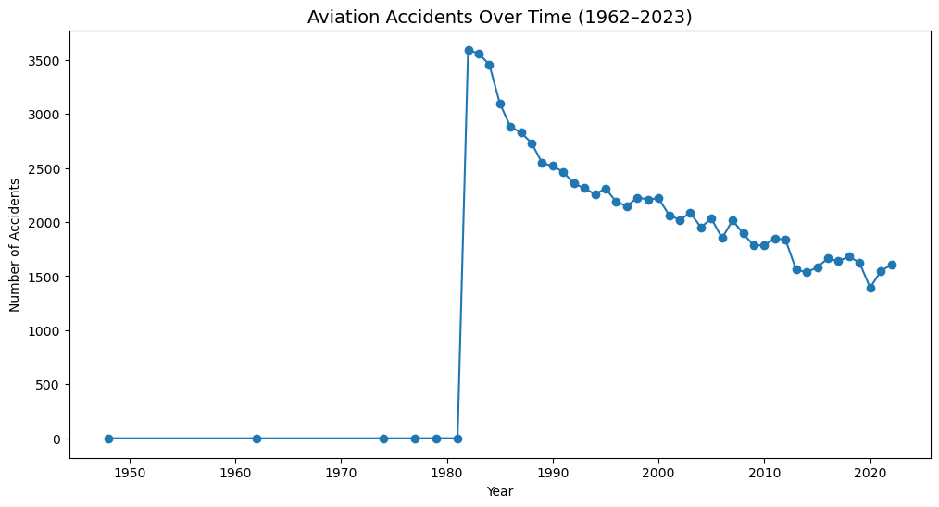
ACCIDENTS PER YEAR

Slide 9
Accidents per
The sharp spike seen around 1982 does not represent an actual surge in accidents but is likely due to a change in reporting or data collection methods. What is more important is the clear downward trend from the mid-1980s to the present, showing continuous improvements in aviation safety. Advances in aircraft technology, stricter regulations, and better training have all contributed to reducing accidents, even as air traffic has increased. Overall, the long-term trend demonstrates that aviation is becoming progressively safer.

Slide 10
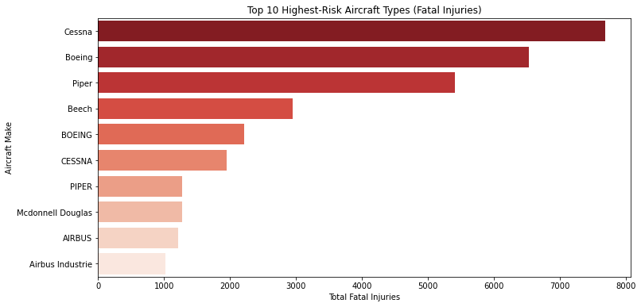
Top 10 Aircraft makes in accidents

Slide 11
Top 10 aircraft make in accidents
The graph shows the top 10 aircrafts make with fata accidents. Notably Cessna, Boeing and piper appear more frequently over the years.
I would recommend a careful consideration before selecting these makes as they may carry a higher level of risk.

Slide 12
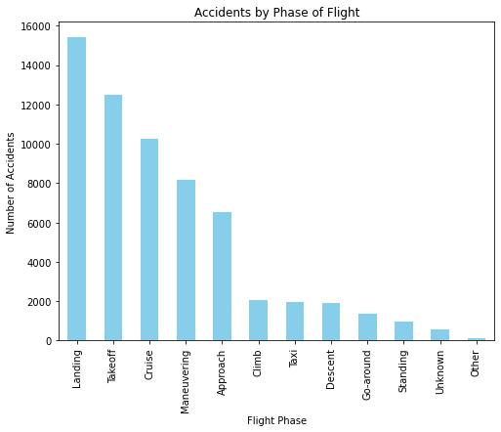
Accident by phase of flight

Slide 13
Accidents by phase of flight
Landing is a critical phase of flight, and pilots must exercise extra care. The graph shows that many accidents over the years have occurred due to incorrect or unsafe landings, highlighting the importance of proper technique and attention during this phase.

Slide 14
RECCOMENDATIONS
Prioritize safer aircraft makes
Exercise caution with high risk makes like Cessna, Boeing and Piper before use.
Emphasize pilot training majorly on landing as it is a critical phase.
Emphasize of safety procedures regulary

